Slide 1
P O RECEPTIVENESS I E

Slide 2

Receptiveness :
" I act with Compassion and Respect "
Show Empathy : Putting yourself in others situation to understand their emotion and perspective.

Slide 3

What is Empathy ?
Empathy is the ability to perceive and relate to the thoughts, emotions, or experiences of others.
Those with high levels of empathy are skilled at understanding a situation from another person’s perspective and reacting with compassion.

Slide 4
Why Empathy is Important in workplace?
Empathy enhances receptiveness:
Understanding needs- When employees and leaders are empathetic they are more likely to interpret feedback, suggestions, and criticism in a constructive manner, which contributes to a receptive atmosphere.
2. Conflict Resolution:
Addressing Issues- Empathy plays a vital role in resolving conflicts by allowing individuals to see things from multiple perspectives and find solutions that consider the emotions and needs of all parties involved.

Slide 5
Why Empathy is Important in workplace?
3. Employee Engagement:
Supportive Environment- When empathy is practiced, employees feel more valued, supported, and understood. This fosters a positive and receptive environment where individuals are more likely to contribute.
4. Innovation and Collaboration:
Diverse Perspective- Empathy encourages individuals to value diverse perspectives and experiences. This can lead to more innovative and problem solving collaboration.

Slide 6


How do I be an empathetic person ?
Active Listening
Open minded
Avoid Judgement
Support each other
Consider other people's perspective.

Slide 7
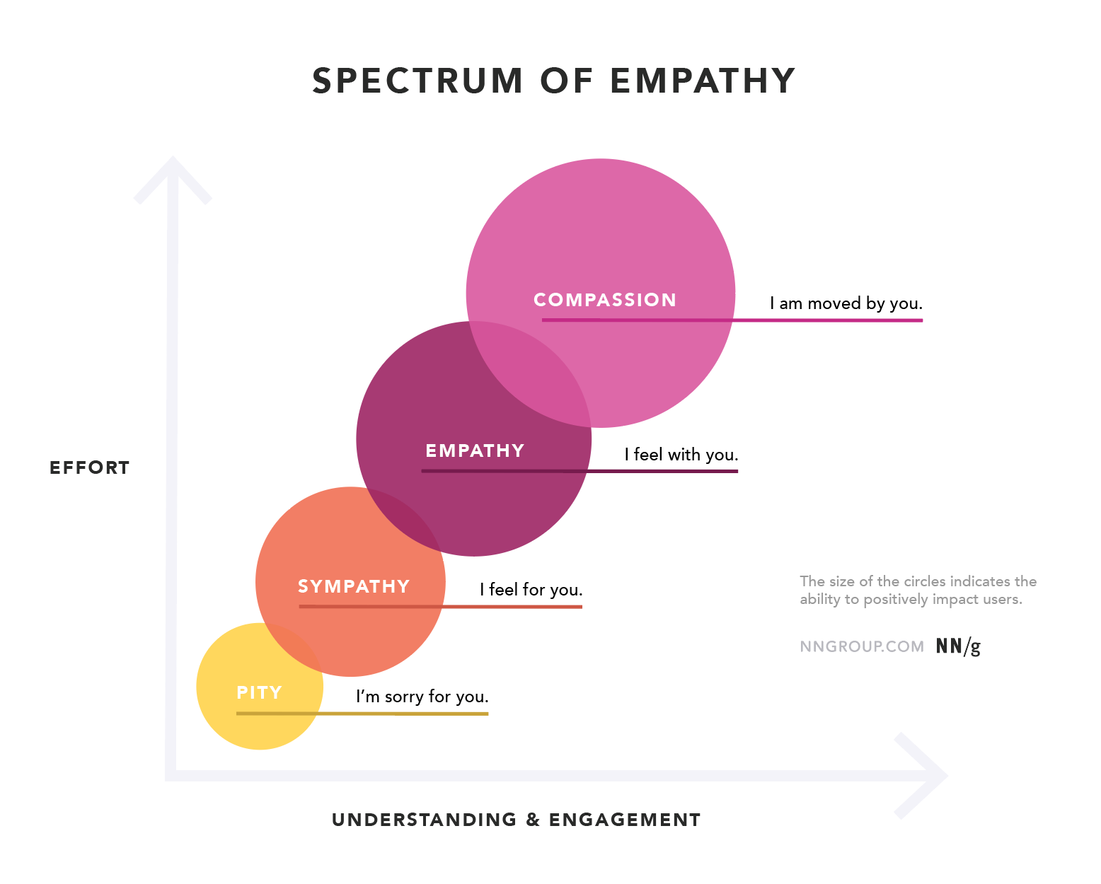
Conclusion :

Slide 8

Q & A:

Slide 9
Madhan Kumar - Trainee Software Engineer

